Slide 1


Team: COPERNICO
Orazio Torre
Carmine Gallo
Vittorio D’Alfonso
Gerardo Nastri

Slide 2


Leveraging Earth Observation Data for Informed Agricultural Decision-Making
Farmers face significant challenges due to unpredictable weather patterns, limited access to satellite data, and a lack of technical skills.
Climate change leads to erratic conditions that disrupt planting and harvesting schedules, resulting in droughts and floods. Many farmers struggle to utilize complex NASA datasets because of the absence of user-friendly interfaces, while a gap in technical expertise hinders their ability to interpret data and apply data-driven solutions effectively. There is a pressing need for better integration of satellite data with on-the-ground observations to provide personalized insights. Additionally, effective risk management tools are essential for enabling farmers to make informed decisions and enhance their resilience against environmental uncertainties.

Slide 3

OUR SOLUTION
Copernico is an innovative app designed to address the complex challenges facing agriculture today, such as climate change, pest infestations, and resource accessibility.
Recognizing the difficulty in translating complex satellite data into actionable insights for farmers, Copernico aims to overcome barriers by presenting information in a clear, intuitive, and farmer-centric manner. This approach facilitates the adoption of advanced scientific data, ultimately making agricultural practices more resilient and sustainable.

Slide 4
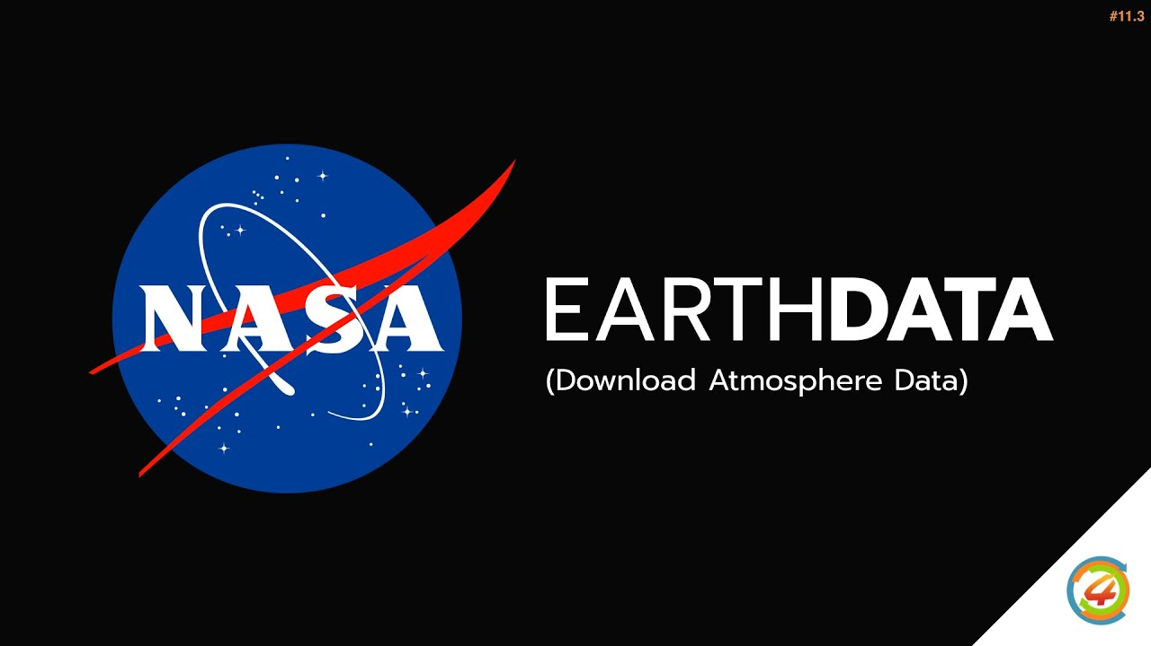
Data Acquisition Strategy
In the first version of our app, we used the NASA POWER API for its speed and ease of access to daily meteorological data. Looking ahead, we plan to integrate NASA Earthdata to meet advanced research needs, as it offers a wider range of near real-time datasets for comprehensive analysis. While it provides significant benefits for advanced research, careful consideration of the implementation timeline is essential.

Slide 5
Architecture and Features
Registration and Login: Access to advanced features such as proximity chat, personalized statistics, real-time notifications, and preference management. The registration process involves a simple onboarding and geolocation of the area of interest.
Home Page: Summary of key functions like advanced reporting and daily suggestions, with easy navigation through a bottom bar.
Statistics: Provides practical advice based on personalized data for crops and livestock, with predictive suggestions for animal welfare and crop management.
Proximity Chat: Geolocated social feed that promotes community interactions based on proximity, allowing text and multimedia posts.
Task Manager with Gamification: Tool for managing agricultural tasks in an engaging way, rewarding users with experience points (XP), badges, and virtual rewards, enhancing engagement and community sharing.

Slide 6
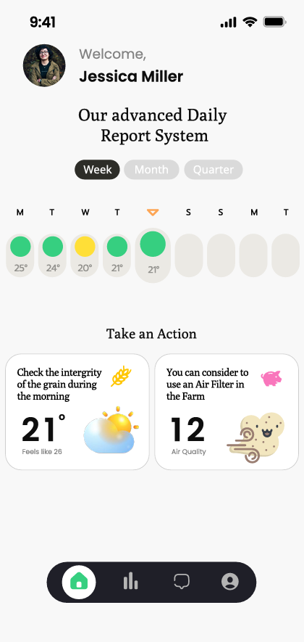
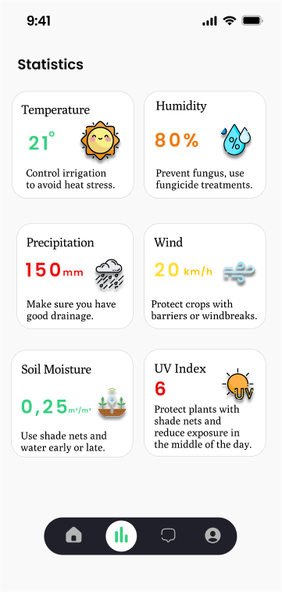
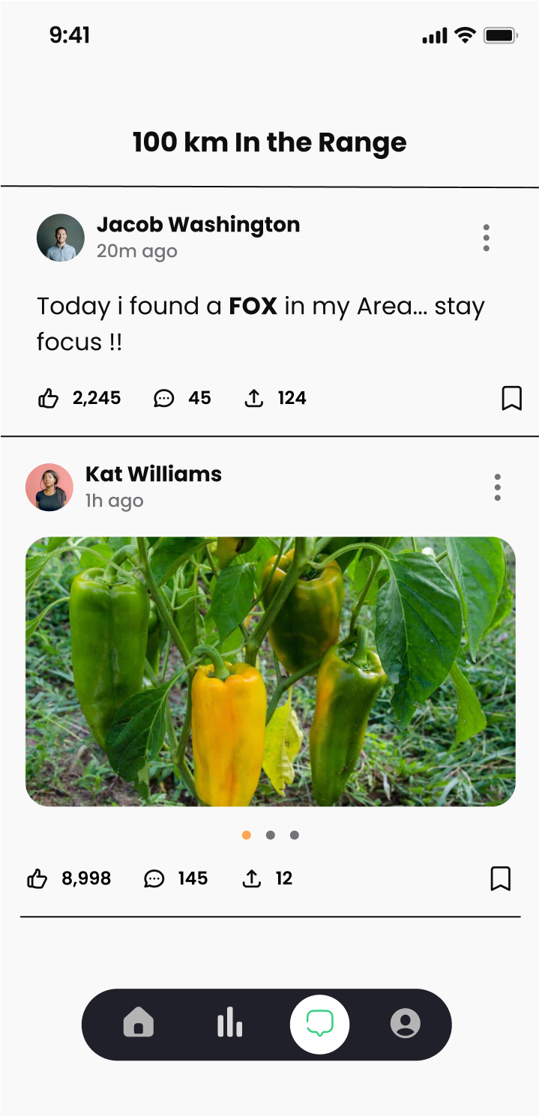
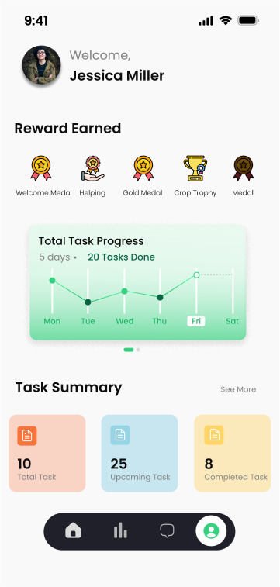
OUR DESIGN PREVIEW

Slide 7
Future Goals and Objectives
Ongoing Development
Ongoing back-end development and implementation to support all planned functionality.
Alert System
System for generating alerts for floods, droughts, or other critical events.
AI & Forecasting
Model using machine learning and statistical methods to generate practical insights from past EarthData.

